Slide 1
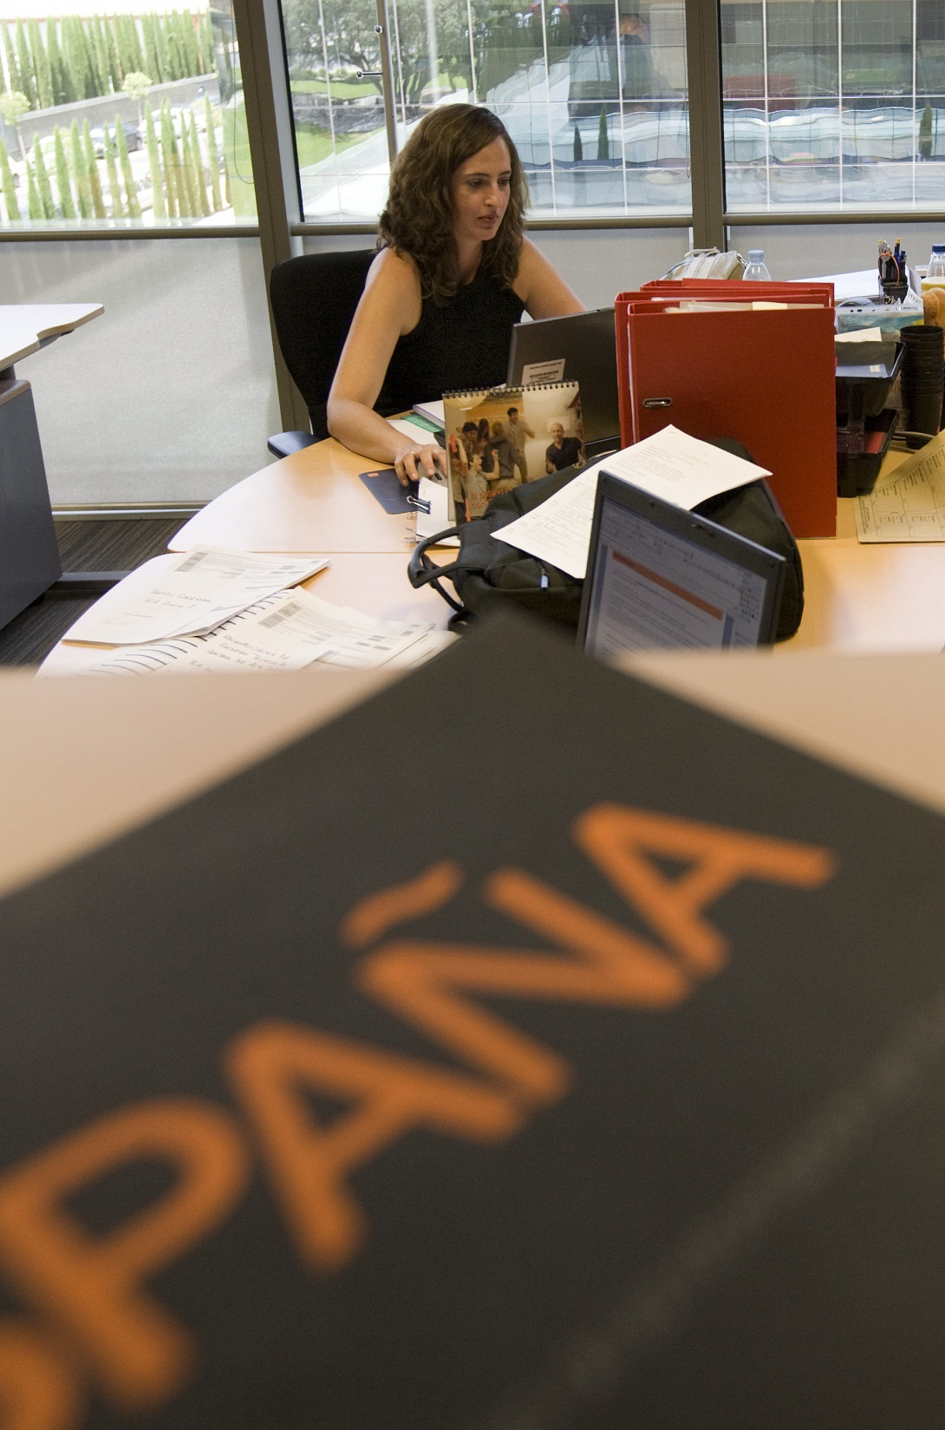
VSSP Presentation 08th February 2017 -version 1.0
SKC & CPM on VSPP Solution

Slide 2
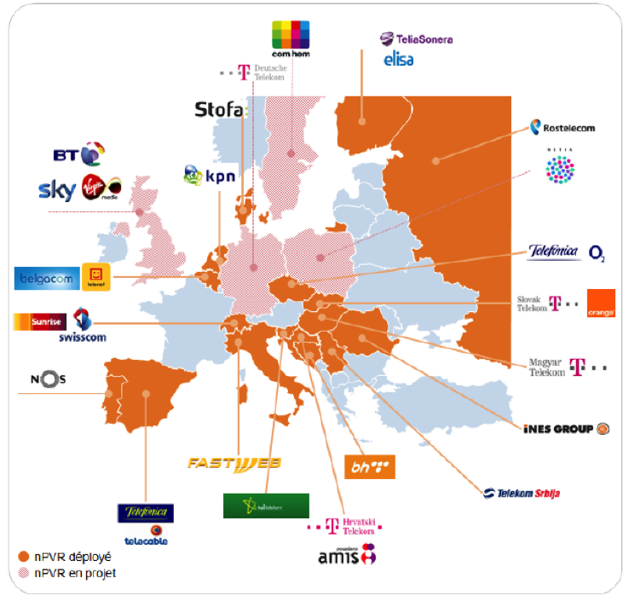




Market Evolution (Jan 2015 source idate)
catch-up
Reverse EPG
Start over
VOD

Slide 3

Solution overview & high level impacts
Solution summary:
VSPP capture and store during 7 days all live channels available in OTT (“rolling buffer”)
When the customer wishes to come back to the beginning of the program, RiGHTv propose to STB / Apps to switch onto the VSPP and read the content stored in the rolling buffer based on the EPG information (program based access).
Multicast lice sessions (IPTV) are switched to “near live” unicast sessions delivered by VSPP.
Content Management System:
Tag contents with STOV rights
SED (Animation) :
Declaration of STOV options on channels.
VSPP:
Reuse of VSPP Component deployed on Salamanca Step 1.
IT/Luna:
Handle the provisioning of STOV option to household.
Session Manager:
SM v2.0 with new rules to manage (stov // catchup and extension on SVOD and VOD)
RiGHTv:
> Configuration and retrofit households for STOV option.
STB & Apps:
Player evolutions to manage specific formats for the manifest file.
Evolution of the user experience to handle the start over feature (I<< button).
Licensers

Slide 4
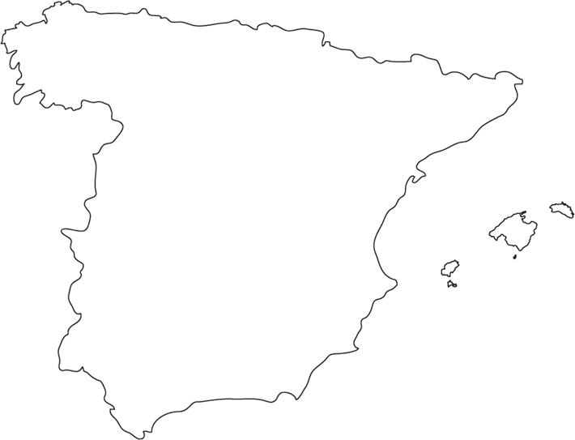











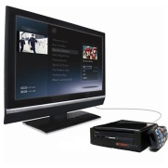



Global overview
COSLADA
MENESES
Live encoders
MPEG2-TS
over IP
MPEG2-TS ABR (mezzanine)
UDP Multicast
CDVR
E// VSPP
DRM +
Packaging HAS
getDrmProtectionInfo
ContentId= channelX
On The Fly
Pull mode
OINS CDN
KMS
MISS: chunk not in cache
CDN Parent caches
OINS POP
CDN
Edge
caches
MD5 token
verification
HAS over HTTP/1.1
in “pull” mode
HTTP GET
Mobile
Devices
Connected
TV
Airties STB
TV dongle

Slide 5












Network interconnection
Coslada
UDP Multicast
ABR mezzanine pivot format:
1 channel = 7 * SPTS MPEG2-TS
1 SPTS = 1 bitrate
H264 video CBR
AAC & HE-ACC V2 audio CBR
Closed GOP (50 frames)
Subtitles : DVB Teletext
MPEG2-TS
over IP
On The Fly
DRM +
Packaging HAS
Live Encoders
Envivio Muse
GET
Live Origin Servers
Envivio Halo
Unicast
OTT Live in HAS
Reliable & Secure
Network
Interconnection
Pull mode
Meneses
HTTP 80/tcp
Multicast forwarding
OINS CDN
DNS Request
Orange CDN:
Parent caches
DNS
53/udp
Authoritative zone
Unicast
VSPP
OTT Live services in HAS
Rolling buffer
7 days
GET
On The Fly
DRM +
Packaging HAS
Pull mode
ACL:
5555/TCP

Slide 6
Orange CDN integration
VSPP is configured in “Live Mode” with a 7 days rolling buffer
The Orange CDN has to retrieve the video and the audio contents (MSS & HLS) from the VSPP nodes by using the “Pull Mode” (HTTP GET method)
VSPP nodes are acting as Live origin servers for all the HAS protocols: each of them can be accessed through their streaming IP address (EGRS VLAN)
In order to select the best VSPP node for streaming, whatever the live channel or the HAS protocol, a dedicated authoritative DNS zone managed by the VSPP managers should be used (ex of internal FQDN: strm.poda.manager.cdrv.local)
The “static” URL format defined by VSPP is predictable and every MSS fragments or HLS chunks can be cached by the Orange CDN
Manifest file (MSS) and playlist (HLS) may be cached but only for 2 seconds: for the same URL, their content could be different on certain use case (Start-Over, NTC) and 2 seconds late could be acceptable
interne Orange

Slide 7
Supported HTTP features
HTTP 1.1 (connection: keep-alive) must be enabled on the CDN to increase the network performance
If the CDN specifies the “Range: bytes=X-Y” header in the request, VSPP will always provide the full content of the fragment with “HTTP 200 OK” and “Content-Length” equals to its total size
The “HTTP Cache-Control: max-age=XXX” response header is managed by VSPP through a specific configuration parameter
The “If-Modified-Since” request header is supported: HTTP code 304 will be returned if the fragment is still in the VSPP node cache. But, because the fragment remains unique, it must be used only if the fragment is requested again by a client and only after the “max-age” period has expired
The “Last-Modified” response header is always “Thu, 01 Jan 1970 00:00:00 GMT”.
interne Orange

Slide 8
Live Smooth Streaming
Playout URL received by the CDN:
URL rewritten by CDN and requested to VSPP:
Example:
http://{cdvr_mss_fqdn}/{token_data}/shss/LIVE${channel_id}/{fragment_length}.ism/
manifest?start=LIVE&end=END&device={device_profile}
cdvr_mss_fqdn: CDVR FQDN for MSS(ex: cdvr-mss.tv.orange.es)
token_data: Verivue data = “token/expiration time/additional data”
channel_id: id of the live channel (ex: CNN, FOX)
fragment_length: length of the HSS fragment in seconds (Default: 2 s)
device_profile: name of the device profile for MSS (ex: MSS_LOW, MSS_HIGH)
http://{vspp_fqdn}:{tcp_port}/shss/LIVE${channel_id}/{fragment_length}.ism/
manifest?start=LIVE&end=END&device={device profile}
vspp_fqdn: FQDN of VSPP (ex: strm.poda.manager.cdvr.internal)
tcp_port: 5555/tcp port used by VSPP for streaming
channel_id: id of the live channel (ex: CNN, FOX)
fragment_length: length of the HSS fragment in seconds (Default: 2 s)
device_profile: name of the device profile for MSS (ex: MSS_LOW, MSS_HIGH)
http://cdvr-mss.tv.orange.es/6Vp8kZhdgEKhULIuvcCaWA/0000000000/null/null/null/shss/
LIVE$FOX/2.ism/manifest?start=LIVE&end=END&device=MSS_LOW
http://strm.poda.manager.cdvr.internal:5555/shss/LIVE$FOX/2.ism/manifest?
start=LIVE&end=END&device=MSS_LOW
interne Orange

Slide 9
Live HLS
Playout URL received by the CDN:
URL rewritten by CDN and requested to VSPP:
Example:
http://{cdvr_hls_fqdn}/{token_data}/shls/LIVE${channel_id}/{chunk_length}.m3u8?
start=LIVE&end=END&device={device_profile}
cdvr_hls_fqdn: CDVR FQDN for MSS(ex: cdvr-hls.tv.orange.es)
token_data: Verivue data = “token/expiration time/additional data”
channel_id: id of the live channel (ex: CNN, FOX)
chunk_length: length of the HLS chunk in seconds (Default: 10 s)
device_profile: name of the device profile for HLS (ex: HLS_LOW, HLS_HIGH)
http://{vspp_fqdn}:{tcp_port}/shls/LIVE${channel_id}/{chunk_length}.m3u8?
start=LIVE&end=END&device={device profile}
vspp_fqdn: FQDN of VSPP (ex: strm.poda.manager.cdvr.internal)
tcp_port: 5555/tcp port used by VSPP for streaming (default: 5555)
channel_id: id of the live channel (ex: CNN, FOX)
chunk_length: length of the HLS chunk in seconds (Default: 10 s)
device_profile: name of the device profile for HLS (ex: HLS_LOW, HLS_HIGH)
http://cdvr-hls.tv.orange.es/6Vp8kZhdgEKhULIuvcCaWA/0000000000/null/null/null/shls/
LIVE$FOX/10.m3u8?start=LIVE&end=END&device=HLS_LOW
http://strm.poda.manager.cdvr.internal:5555/shls/LIVE$FOX/10.m3u8?start=LIVE&
end=END&device=HLS_LOW
interne Orange

Slide 10
Catch-up, Reverse EPG, Start-Over & NTC in MSS
Player URL received by the CDN:
URL rewritten by CDN and requested to VSPP:
Example (FOX: 1 hour program on 2016-Mar-03 at 10am GMT):
http://{cdn_mss_fqdn}/{token_data}/shss/LIVE${channel_id}/{fragment_length}.ism/
manifest?start={start_time}&end={end_time}&device={device_profile}
cdvr_mss_fqdn: CDVR FQDN for MSS (ex: cdvr-mss.tv.orange.es)
token_data: Verivue data = “token/expiration time/additional data”
channel_id: id of the live channel (ex: CNN, FOX)
fragment_length: length of the HSS fragment in seconds (Default: 2 s)
start_time: iso timestamp (UTC) ➔ start of the program (yyyy-MM-ddTHH:MM:SSZ)
end_time: iso timestamp (UTC) ➔ end of the program (yyyy-MM-ddTHH:MM:SSZ)
device_profile: name of the device profile for MSS (ex: MSS_LOW, MSS_HIGH)
http://{vspp_fqdn}:{tcp_port}/shss/LIVE${channel_id}/{fragment_length}.ism/
manifest? start={start_time}&end={end_time}&device={device profile}
vspp_fqdn: FQDN of VSPP (ex: strm.poda.manager.cdvr.internal)
tcp_port: 5555/tcp port used by VSPP for streaming
channel_id: id of the live channel (ex: CNN, FOX)
fragment_length: length of the HSS fragment in seconds (Default: 2 s)
start_time: iso timestamp (UTC) ➔ start of the program (yyyy-MM-ddTHH:MM:SSZ)
end_time: iso timestamp (UTC) ➔ end of the program (yyyy-MM-ddTHH:MM:SSZ)
device_profile: name of the device profile for MSS (ex: MSS_LOW, MSS_HIGH)
http://cdvr-mss.tv.orange.es/6Vp8kZhdgEKhULIuvcCaWA/0000000000/null/null/null/shss/
LIVE$FOX/2.ism/manifest?start=2016-03-04T10:00:00Z&end=2016-03-04T11:00:00Z&device=MSS_LOW
http://strm.poda.manager.cdvr.internal:5555/shss/LIVE$FOX/2.ism/manifest?
start=2016-03-04T10:00:00Z&end=2016-03-04T11:00:00Z&device=MSS_LOW
interne Orange

Slide 11
Catch-up, Reverse EPG, Start-Over & NTC in HLS
Playout URL received by the CDN:
URL rewritten by CDN and requested to VSPP:
Example (FOX: 1 hour program on 2016-Mar-03 at 10am GMT):
http://{cdvr_hls_fqdn}/{token_data}/shls/LIVE${channel_id}/{chunk_length}.m3u8?
start={start_time}&end={end_time}&device={device_profile}
cdvr_hls_fqdn: CDVR FQDN for HLS (ex: cdvr-hls.tv.orange.es)
token_data: Verivue data = “token/expiration time/additional data”
channel_id: id of the live channel (ex: CNN, FOX)
chunk_length: length of the HLS chunk in seconds (Default: 10 s)
start_time: iso timestamp (UTC) ➔ start of the program (yyyy-MM-ddTHH:MM:SSZ)
end_time: iso timestamp (UTC) ➔ end of the program (yyyy-MM-ddTHH:MM:SSZ)
device_profile: name of the device profile for HLS (ex: HLS_LOW, HLS_HIGH)
http://{vspp_fqdn}:{tcp_port}/shls/LIVE${channel_id}/{chunk_length}.m3u8?
start={start_time}&end={end_time}&device={device profile}
vspp_fqdn: FQDN of VSPP (ex: strm.poda.manager.cdvr.internal)
tcp_port: 5555/tcp port used by VSPP for streaming
channel_id: id of the live channel (ex: CNN, FOX)
chunk_length: length of the HLS chunk in seconds (Default: 10 s)
start_time: iso timestamp (UTC) ➔ start of the program (yyyy-MM-ddTHH:MM:SSZ)
end_time: iso timestamp (UTC) ➔ end of the program (yyyy-MM-ddTHH:MM:SSZ)
device_profile: name of the device profile for HLS (ex: HLS_LOW, HLS_HIGH)
http://cdvr-hls.tv.orange.es/6Vp8kZhdgEKhULIuvcCaWA/0000000000/null/null/null/shls/
LIVE$FOX/10.m3u8?start=2016-03-04T10:00:00Z&end=2016-03-04T11:00:00Z&device=HLS_LOW
http://strm.poda.manager.cdvr.internal:5555/shls/LIVE$FOX/10.m3u8?start=2016-03-04T10:00:00Z&end=2016-03-04T11:00:00Z&device=HLS_LOW
interne Orange

Slide 12
Fragment URL with DRM protection
Smooth Streaming URL protected by DRM:
URL of an HLS chunk protected by DRM:
http://{cdn_mss_fqdn}/{token_data}/shss/LIVE${channel_id}/{fragment_length}.ism/{DRM_profile}/
QualityLevels({bitrate_level})/{method}({track_id}={timestamp})
cdvr_mss_fqdn: CDVR FQDN for MSS (ex: cdvr-mss.tv.orange.es)
token_data: Verivue data = “token/expiration time/additional data”
channel_id: id of the live channel (ex: CNN, FOX)
fragment_length: length of the HSS fragment in seconds (Default: 2 seconds)
DRM_profile: name of the DRM profile defined in the VSPP configuration (ex: ORCA_MSS_DRM)
bitrate_level: bitrate level in b/s (ex: 680Kb/s ➔ 713031)
method: [fragments|fragmentInfo|KeyFrames]
track_id: name of the audio/video track (ex: video)
timestamp: timestamp in ms (UTC epoch time) (ex: Thu, 28 Apr 2016 13:54:12 GMT ➔ 1461851652000)
http://{cdvr_hls_fqdn}/{token_data}/shls/LIVE${channel_id}/{chunk_length}.m3u8 /{DRM_profile}/Level({bitrate_level})/Segment({timestamp})
cdvr_hls_fqdn: CDVR FQDN for HLS (ex: cdvr-hls.tv.orange.es)
token_data: Verivue data = “token/expiration time/additional data”
channel_id: id of the live channel (ex: CNN, FOX)
chunk_length: length of the HLS chunk in seconds (Default: 10 s)
DRM_profile: name of the DRM profile defined in the VSPP configuration (ex: ORCA_HLS_DRM)
bitrate_level: bitrate level in b/s (ex: 2.1 Mbps ➔ 2202009)
timestamp: timestamp in ms (UTC epoch time) (ex: Thu, 28 Apr 2016 13:54:12 GMT ➔ 1461851652000
interne Orange

Slide 13

DNS authoritative zone managed by VSPP
Edge cache ➔ Parent: GET http://cdvr-mss.tv.orange.es
Parent ➔ VSPP: DNS Query http://strm.poda.manager.cdvr.internal
VSPP ➔Parent: DNS Reply 172.16.0.B
Parent ➔VSPP: GET http://172.16.0.B
Parent ➔ Edge: HTTP object (fragment, manifest)
OINS POP
OINS POP
1
Parent caches
2
1
3
4
2
5
5
Edge caches
DNS reply
Meneses
DNS
53/udp
OTT Live services in HAS
DNS query
4
3
GET HTTP/1.1
Authoritative zone
➔cdvr.internal
Streaming ACL:
Inbound: 5555/TCP
Load Balancing
Video
Storage
Processing
Platform
A
B
C
D
E
EGRS VLAN : 172.16.0.X

Slide 14











Corporate nPVR enabler
Fabrix Scheduler Archive API
HTTP 1.1 POST XML
Cloud DVR Enabler
HTTPS
Server Content Key
Cloud DVR controller (1+1)
SOAP Request over HTTPS
TV middleware
XML Response: Status
Key License Server
CTRL1
(active)
CTRL2
(passive)
HTTP
A
P
xCAT
Multicast
Packaging
DRM
MPEG2-TS ABR
(Multicast UDP)
REC1
STR1
HTTP Adaptive Streaming
A
A
HTTP 1.1 GET (Pull mode)
HSS
HLS
DASH
DNS LB
REC2
STR2
Live Encoder
A
A
CDN Parent cache
FQDN: http://npvr-orange.net
VPN
HTTP
Cloud DVR cluster
Management:
admin, monitoring, backup
REC Recorder node
STR Streamer node
CTRL Controller server
Active (master)
Passive (backup)
Stateful Firewall
Port switch ACL
Extreme Cloud Admin Toolkit
DNS Load Balancer
xCAT
A
DNS LB
Orange support teams
P

Slide 15

Rolling Buffer model – Pause Live TV use case
Channel n
Channel B
Channel A
Pause was pressed
Delete old chunk and write new one to the buffer
Resume was pressed
Live availability
In CDVR level , the live program is available after 2 GOPs (GOP: Group of successive pictures. Ex: 25 Pictures per second ➔ GOP of 2s = 50 pictures)
The rolling buffer erases automatically the oldest chunk after the configured retention period.
No storage into the grid

Slide 16



Rolling Buffer model and Inner Asset Block – Record TV use case
Inner Asset Block Never locked
No Backup~ Delete action
Channel n
Inner Asset Block n+4
Inner Asset Block n+3
Channel B
Inner Asset Block n+2
Inner Asset Block n+1
Inner Asset Block n
Asset Block n+3
Asset Block n
Delete after retention period or delete by the user
Channel A
Asset Block n+2
Asset Block n+1
Grid storage
Instant, Time based, EPG record done by the users
End of the record
The Asset Block
The asset corresponding to X Chunks for several minutes. The asset duration is fixed 30 minutes. (best trade off for accessing Database)
The asset is locked and stored into the CDVR over x days (example of retention period)

Slide 17











JITP: Just In Time Packaging + DRM
Ericsson VSPP
CDVR Nodes
GetDRMProtectionInfo
Key Management
Server
HTTPS
Key
JITP
+
DRM
Rolling buffer
7 days
CACHE MISS
Live channels stored in
VSPP (ABR pivot format)
GET http://node1/shss/LIVE$FOX/2.ism/
manifest?device=SMOOTH
Akamai CDN
Prefetch + cache
chunks are cached temporaly
Hyper
Caches
HTTP
HAS over HTTP/1.1 in “pull” mode
VIP
GET http://node1/shss/LIVE$FOX/2.ism/
manifest?device=SMOOTH
HAS URL protected
by a MD5 token
GET Player License
over HTTPS
Internet
Key License
Server

Slide 18
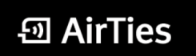


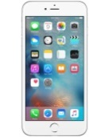











2 Ecosystems for testing
One roof OSP- Pre production context
Airties STB
OSP
Menesses Data Center
IPAD
Android
E// Video Storage and Processing Platform
Unicast
OTT Live services in HAS
On The Fly
DRM +
Packaging HAS
MD5 token
verification
Rolling buffer
7 days
OINIS CDN:
Pair of parent caches
NTVQ3
France
CDVR
Time
Shifting
Start
Over
NTC
Reverse
EPG
Catch
Up
nPVR
HTTPS
Connected TV
getDrmProtectionInfo
ContentId= channelX
Viaccess
Viaccess
Key
License
Server

Slide 19
Garcias
Merci
Thank you
19

